Slide 1
Sign Language Based Communication System For Deaf And Dumb Person
Bilal Abbas
M.Faizan Shafiq
Members:
Semester Project
Coordinator:
Prof. Dr.Saima Gulzar

Slide 2
INTRODUCTION
- Project includes 2 Phases
            Speak to Sign.
            Sign to speak.
- It also Includes
            Learning Phase.
                Related Sign to a specific word.

Slide 3
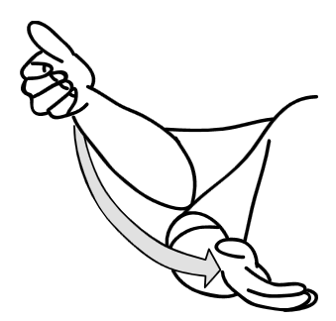
Speak To Sign
In this Phase signs or video will appear with respect to specific word or sentence.
You are welcome

Slide 4

Sign To Speak
This phase includes the sign which will be processed to generate an output in the form of voice.
Thank You in the Form of Voice

Slide 5
Learning Phase
This phase include learning for those who want to learn about the sign, often used for communication.
          Words Processed to give Pictures.
          Learning Phase.

Slide 6
Relevant Work
AAWAAZ: A communication system for deaf and dumb [1].
DEAFCOM: The Deaf Communications Assistant [2].
Deaf Helper: An aid to communication with deaf people [3].
Tawasulli: Arabic communication system [4].
[1] http://ieeexplore.ieee.org/document/7785029/
[2] https://play.google.com/store/apps/details?id=defcom.v1&hl=en
[3] https://play.google.com/store/apps/details?id=com.adkam.DeafHelper&hl=en
[4] https://play.google.com/store/apps/details?id=com.tawaasuly.ddcommunication&hl=en
References:

Slide 7
Methodology
Web Base Application
  2 phases and Learning System.
Android Application(OPTIONAL)
    All functionality of Web Base application.

Slide 8
Thank You.

